Slide 1
Free Falling Bodies without air resistance
MAT313

Slide 2
TEAM
Maryam Eslam 221100500 (AIS)
Nabila Ahmed 221100674 (AIS)
Samira Samir 221101769 (AIS)
Omar Walid 221100759 (AIS)

Slide 3
Abstract
Falling with Air Resistance As an object falls through air, it usually encounters some degree of air resistance. Air resistance is the result of collisions of the object's leading surface with air molecules. The actual amount of air resistance encountered by the object is dependent upon a variety of factors. To keep the topic simple, it can be said that the two most common factors that have a direct effect upon the amount of air resistance are the speed of the object and the cross-sectional area of the object. Increased speeds result in an increased amount of air resistance. Increased cross-sectional areas result in an increased amount of air resistance

Slide 4
What if we made an experiment on a ball of steel and a feather with same diameter in a closed vacuum what would happen ? What will happen is that both of them will reach the bottom at the same time because we neglected the air resistance and pressure so this experiment shows us that how important is the air resistance in free falling

Slide 5
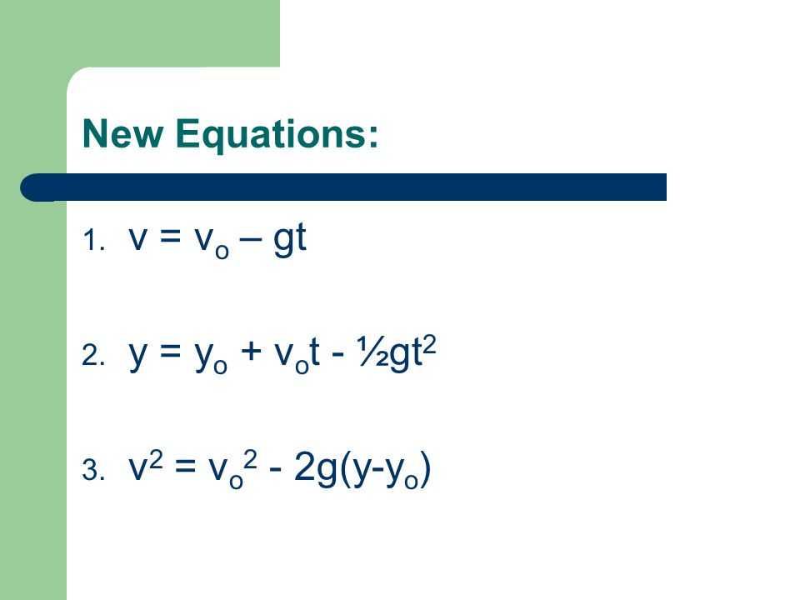
Kinematics EQUATIONS FOR OBJECTS IN FREE-FALL WHERE ACCELERATION = -G

Slide 6
Example 1: Calculating Position and Velocity of a Falling Object: A Rock Thrown Upward
A person standing on the edge of a high cliff throws a rock straight up with an initial velocity of 13.0 m/s. The rock misses the edge of the cliff as it falls back to earth. Calculate the position and velocity of the rock 1.00 s, 2.00 s, and 3.00 s after it is thrown, neglecting the effects of air resistance.
Reference : https://pressbooks.bccampus.ca/collegephysics/chapter/falling-objects/

Slide 7
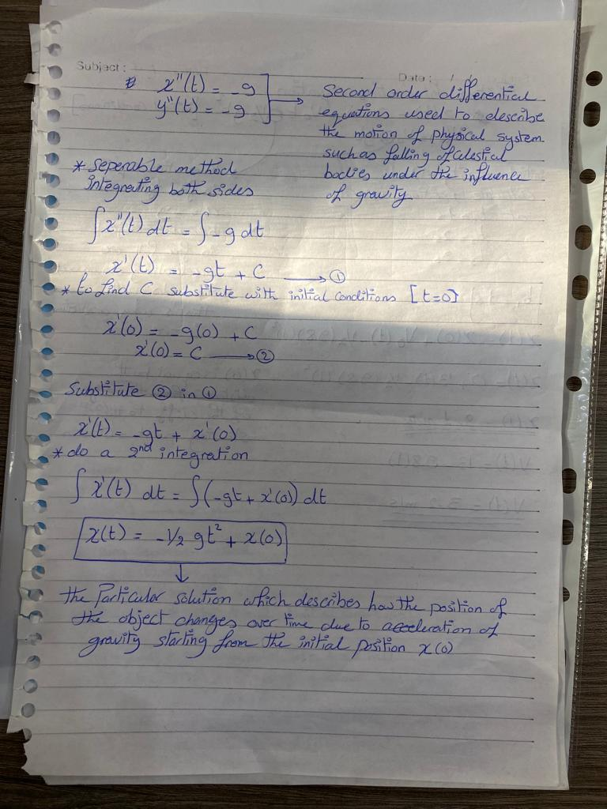
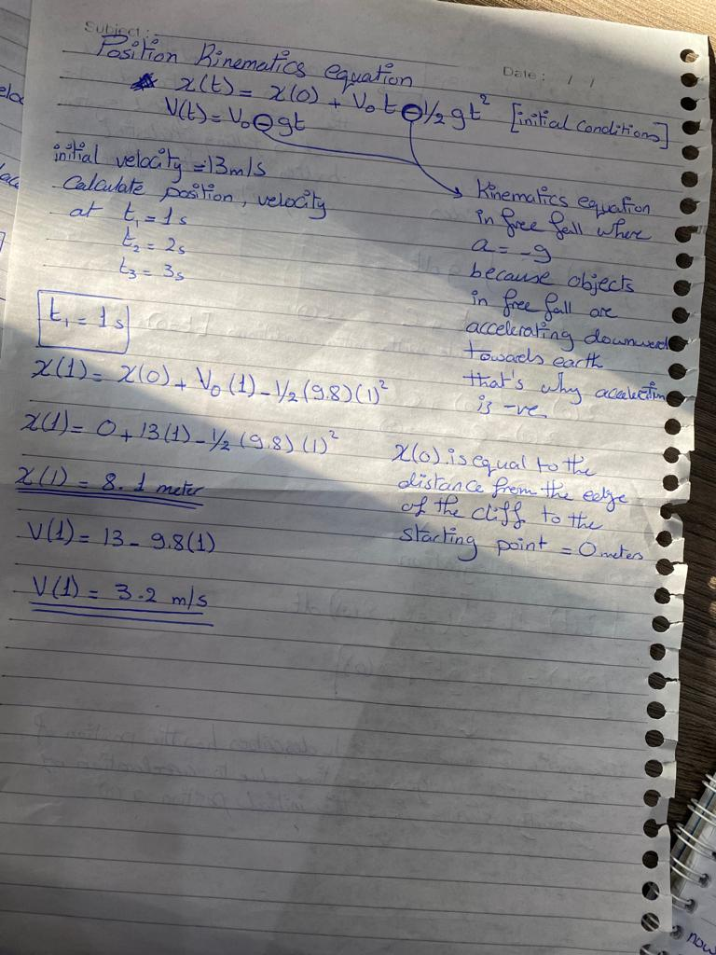

Slide 8
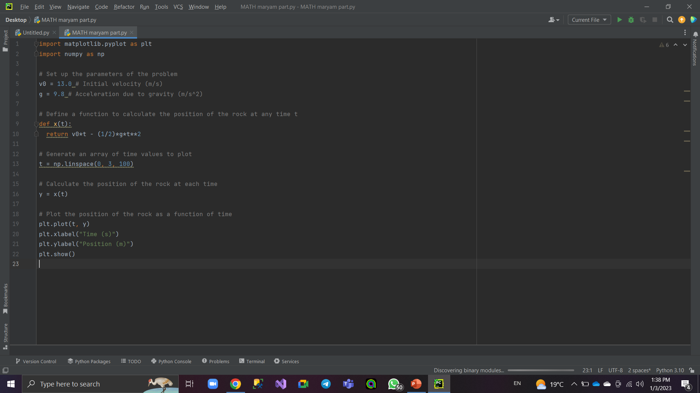

Slide 9
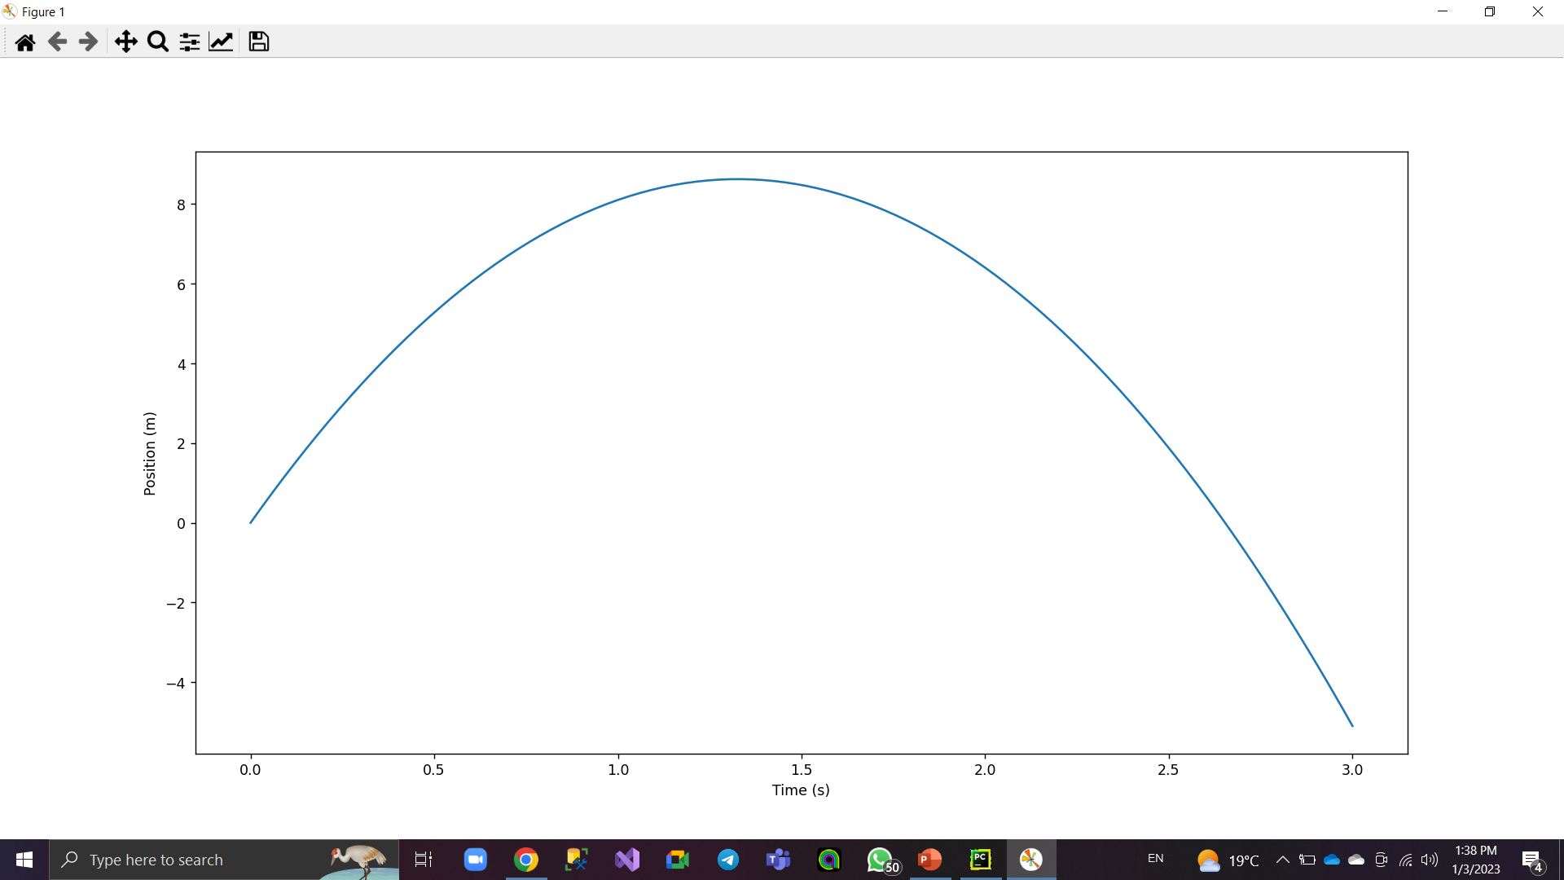

Slide 10
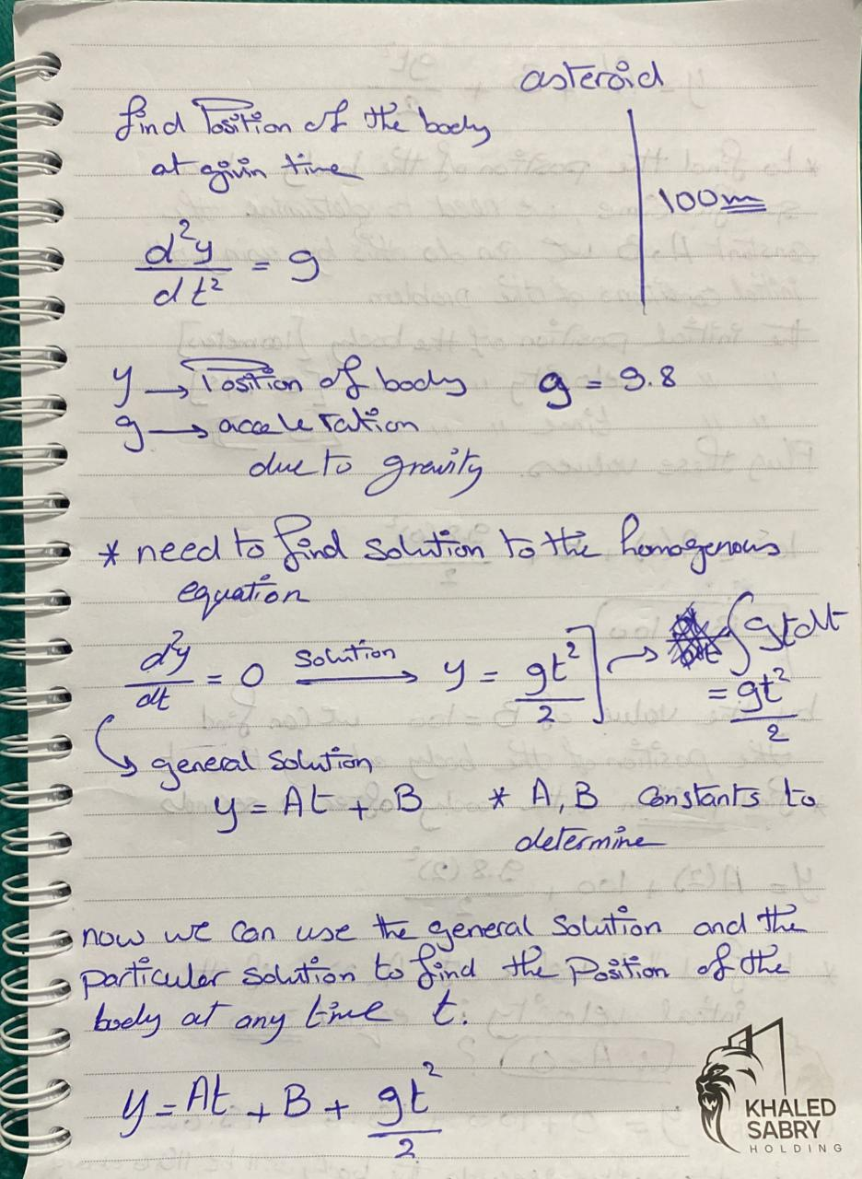
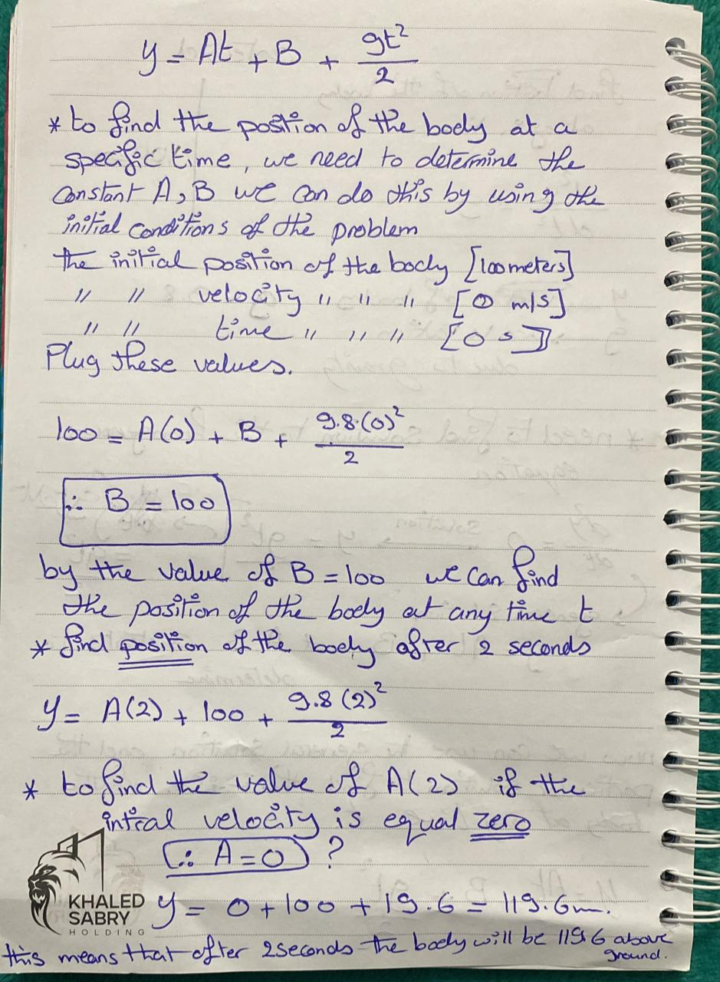

Slide 11
Numerical DE part
03
01
Euler’s Code
Range Kutta’s code
02
Improved Euler’s Code

Slide 12
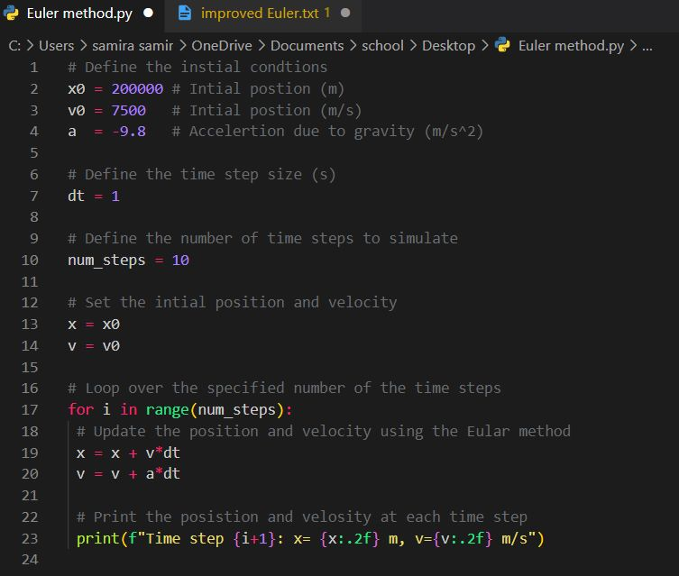
01 Euler’s code

Slide 13
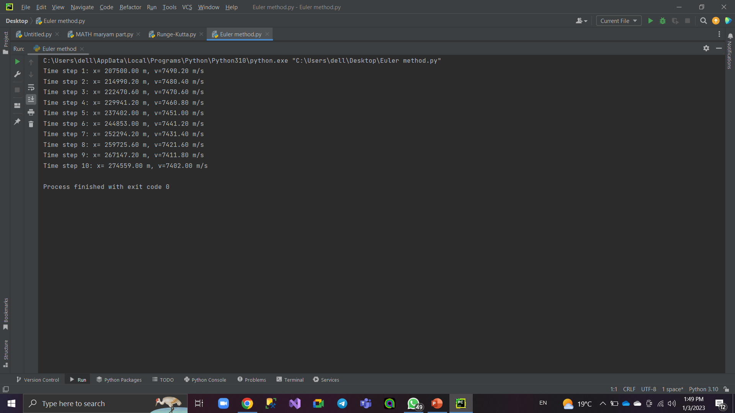

Slide 14
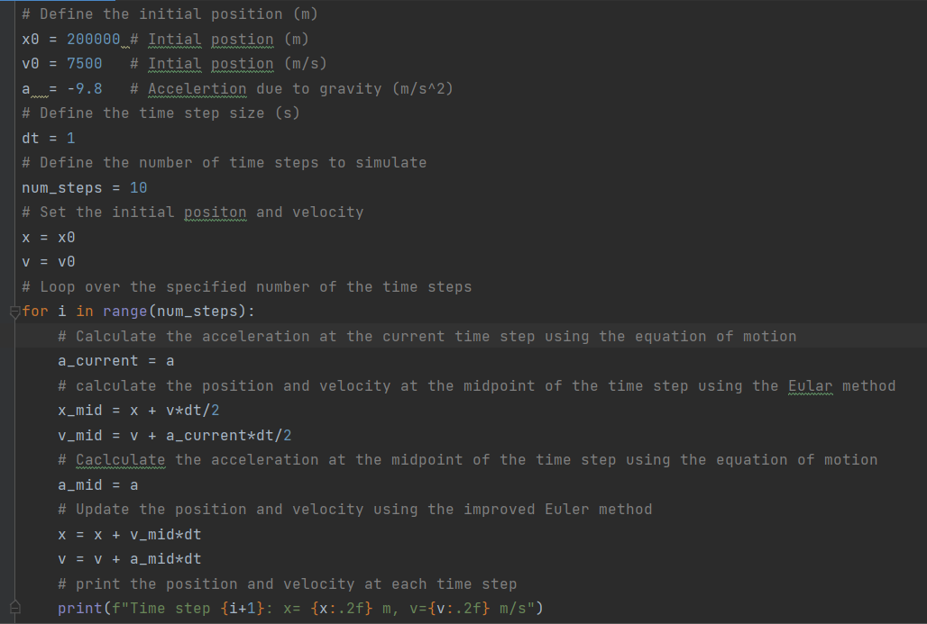
02 Improved Euler’s code

Slide 15
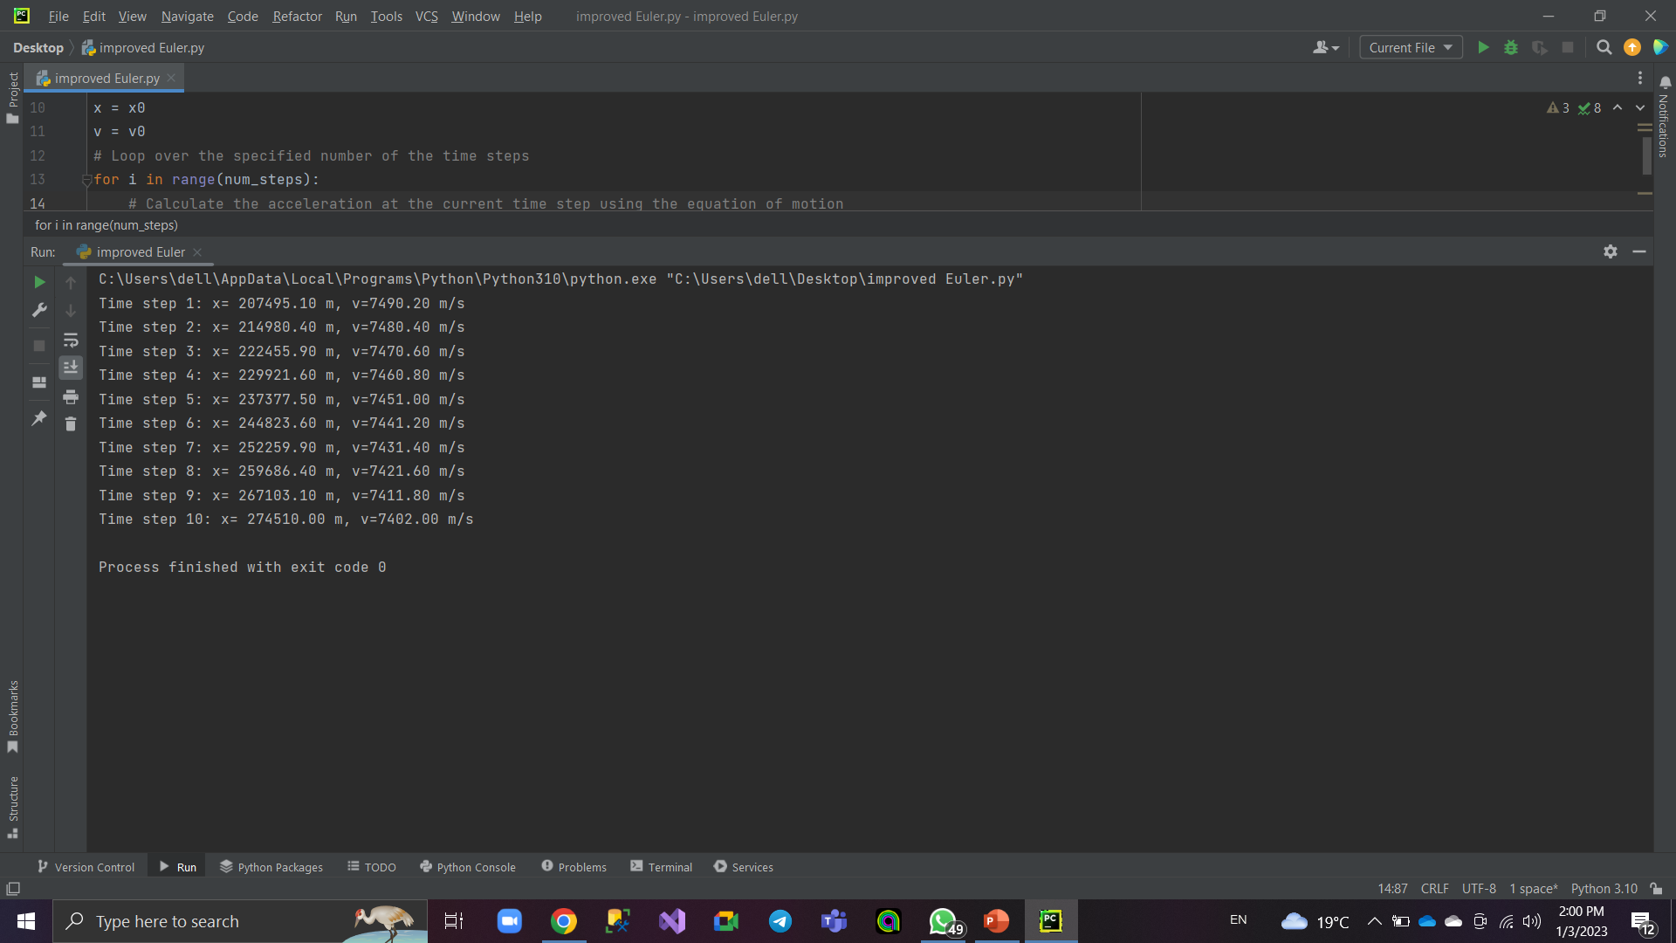

Slide 16
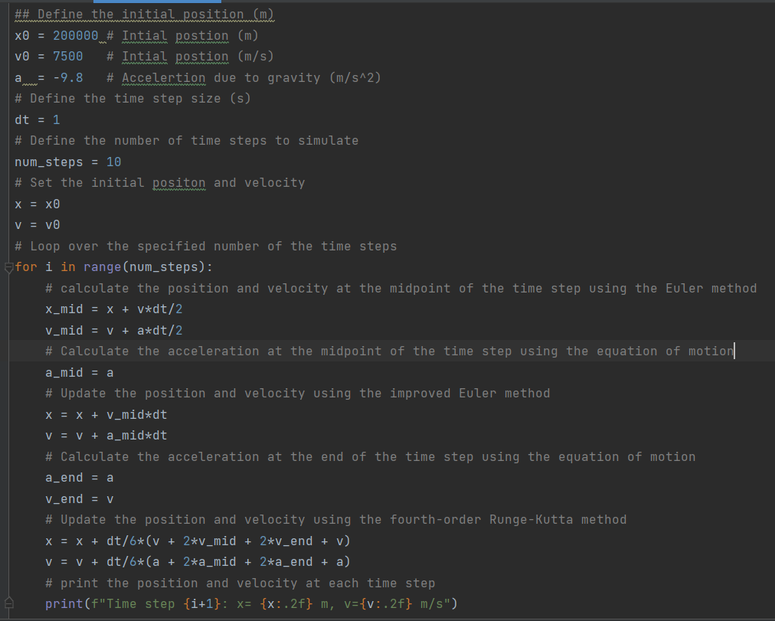
03 Range Kuttas’s code

Slide 17
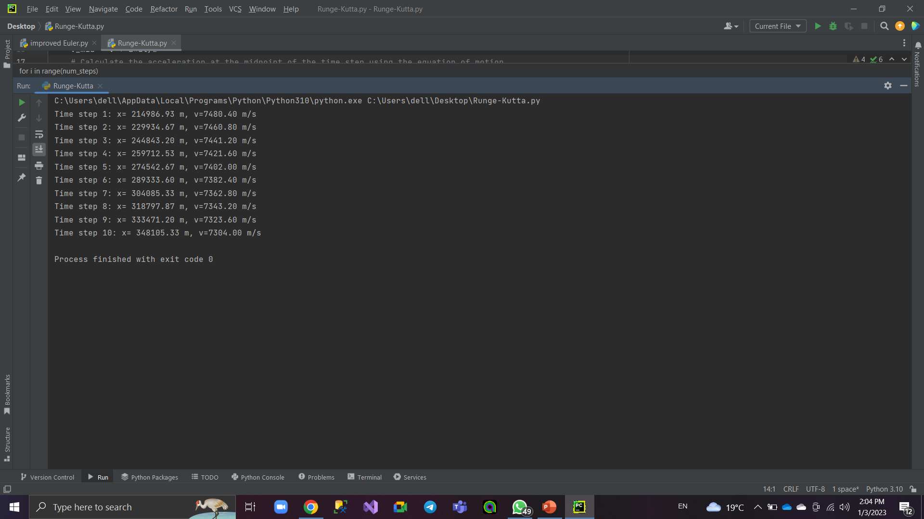

Slide 18
Thank you!
Do you have any questions?

